Slide 1
DUD* Public Comment
Letter Writing Party
GLEA
Port Huron, MI
Feb. 22, 2017
Kevin Kamps
Beyond Nuclear

Slide 2

*DGR? No, DUD!*
*Dave Martin,
Greenpeace Canada*
*DUD?
Deep
Underground
Dump
v.
Deep
Geologic
Repository*

Slide 3
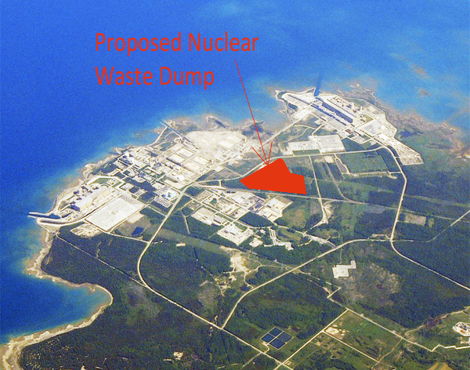
2001-2017…
The Fight Goes On!

Slide 4
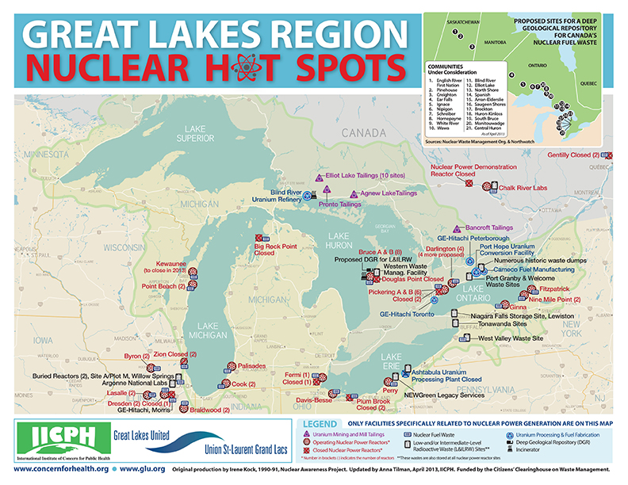
We need to slay this beast…so we can slay all the other beasts*:
(no offense to beasts; perhaps I should have said monsters?!)

Slide 5
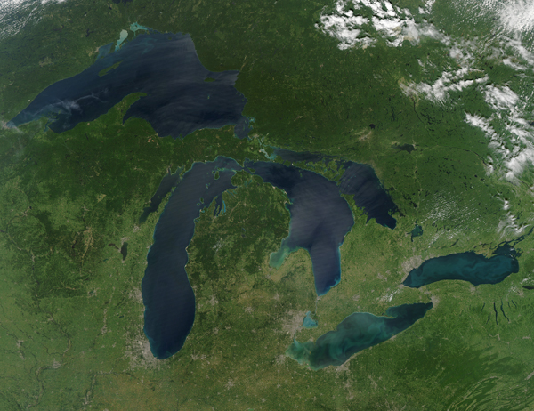
Mni Wiconi…Water IS Life

Slide 6
The Great Lakes:
Drinking water for 40 million people in eight U.S. states, two Canadian provinces, and a very large number of Native American First Nations
Lifeblood of one of the world’s biggest bio-regional economies (fisheries, tourism, recreation, drinking water, industry, property values, etc.)

Slide 7
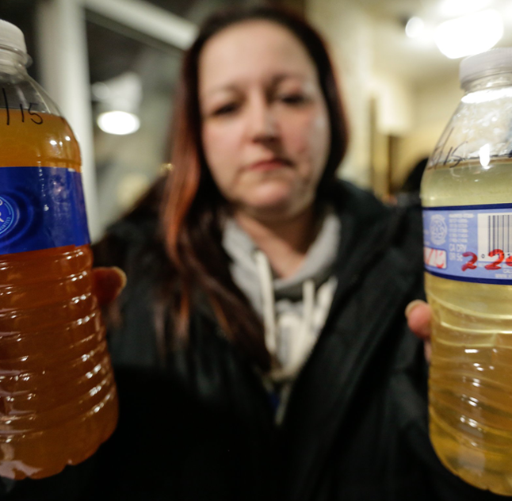

After Flint, Don’t Let Them NUKE the Great Lakes Next!
Flint’s “Momma Bear,”
Lee-Anne Walters
Dr. Mona Hanna-Attisha

Slide 8
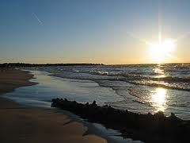
SOSGLs (Save Our Shores-Great Lakes): Our Message to the Minister
Lake Huron
Jill Taylor, SOSGLs, Feb. 14, 2017:
The OPG plan should be rejected outright, now
OPG has not answered your questions and is irresponsible and devious
You continue to ignore the OTHER points of dispute that we have raised, summarized in our letters to you from November 2015, on a total of 8 infractions of the CEAA 2012
Why are you just asking “THESE” questions?

Slide 9
SOSGLs: 8 Reasons to Stop the DGR
Abandoned Science
Alternative Sites
Proof of Sustainability
Public Health and Safety
International Commitments
Public Acceptance
Incomplete Report
Regulators and Regulated

Slide 10
Environment Minister’s questions to OPG (Feb. 2016):
Actual alternate locations
Cumulative impacts of DGR1 & DGR2 (and don’t forget about DGR3!)*
Mitigation measures for negative impacts
*DGR1: targeted at Bruce Nuclear Generation Station (BNGS) in Kincardine on the Lake Huron shore, a dump for 200,000 cubic meters of “low” and “intermediate” level radioactive wastes from operations and refurbishment activities at 20 Ontario Power Generation (OPG) atomic reactors;
DGR2: a dumpsite for all of Canada’s (22 reactors) highly radioactive irradiated nuclear fuel (three municipalities near BNGS are still in the running for DGR2);
DGR3: Late in the licensing process, OPG was forced to admit that another 200,000 cubic meters of “low” and “intermediate” level radioactive waste from decommissioning permanently shutdown reactors would also be dumped at DGR1, doubling its waste inventory.

Slide 11
Actual alternate locations?
Grand Portage, MN, USA (gas station/convenience store! Whoops!)
Lake Erie (Double whoops!)
The chic neighborhood of Chaplin Estates, Toronto (Triple whoops!)

Slide 12
Mitigation measures?!
OPG and CNSC (Canadian Nuclear Safety Commission) would be in charge? They can’t be trusted!
Re: SOSGL’s “Regulators and Regulated,” above, CNSC and OPG are in cahoots, in a bad way
The Japanese Parliament, after a year-long independent investigation, concluded that the root cause of the Fukushima nuclear catastrophe was “collusion” between regulatory agencies, the nuclear power industry, and government/elected officials. Such collusion exists in spades re: the DGR.

Slide 13
Cumulative Impacts
DGR1
DGR2
DGR3
EJ – SON (Environmental Justice, or “radioactive racism,” given Bruce NGS’s location on Saugeen Ojibwe Nation (SON) territory)
See Beyond Nuclear’s written testimony, and power point presentation, submitted/presented to the Joint Review Panel in Sept., 2013 re: the very large number of nuclear and other dirty, dangerous energy industry cumulative impacts on the Great Lakes, posted online at: http://www.beyondnuclear.org/canada/2013/9/28/momentum-building-of-international-opposition-against-opg-du.html

Slide 14
For more info:
http://www.beyondnuclear.org/canada/
http://bruce-nuclear-waste-burial.weebly.com/
http://stopthegreatlakesnucleardump.com/
http://www.sosgreatlakes.org/
www.ccnr.org (Do a search for OPG's proposed DGR)
www.northwatch.org/
http://www.knownuclearwaste.ca/ (focused mainly on high level radioactive waste or irradiated fuel in Canada – that is DGR2 -- but has some information on OPG's proposed DGR1)

Slide 15
Key Official Documents re: DGR1
The CEAA's Public Registry on the proposed deep underground dump
The February 2016 letter from Minister to OPG requiring additional information from OPG
OPG's "additional information" is posted here: CEAR # 2883

